Slide 1
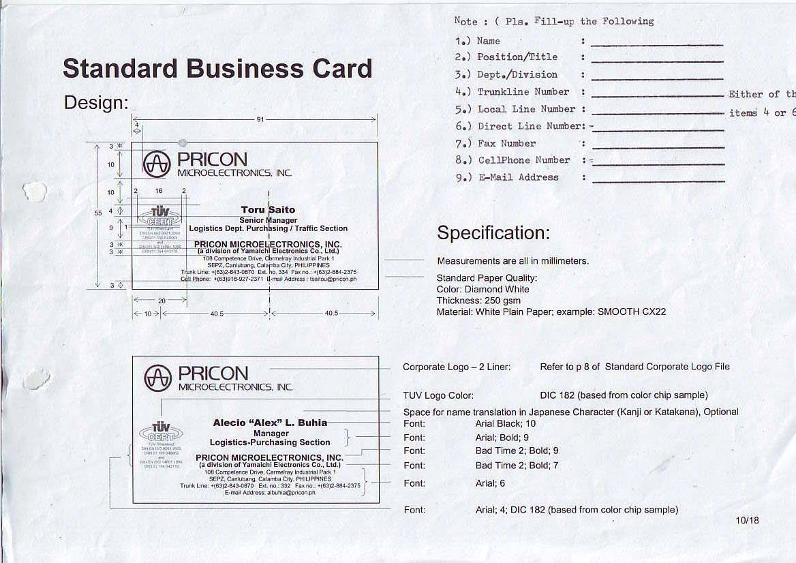
Darwin L. Tipdas
Assistant Manager
TS Engineering
+(63) 2-843-0870
135
--
+(63) 2-843-0870 Loc. 301
+(63)998-850-8576
dltipdas@pricon.ph

